Slide 1
Project Overview
Heart disease prediction
Team Members:
Leo Ennis - X00226717
Illia Lysennyi - X00220405
Emmanuel Fulfilled - X00227373

Slide 2

Introduction
This project focuses on predicting heart disease using Machine Learning.
We aim to build reliable models using structured datasets
The goal is to improve early heart disease detection through data driven decisions

Slide 3

01
Problem Statement and Research

Slide 4
Challenge Definition
Heart disease is the leading cause of death with approximately 19.8 million deaths per year according to the World Health Organization
Predicting the presence or absence of heart disease from patient data is a binary classification problem
The challenge is building accurate models while working with different types of patient data 0
Cardiovascular diseases (CVDs)

Slide 5
Existing Models Overview
The research uses multiple advanced models as benchmarks to compare our future results.
Some common machine learning models used would be logistic regression, random forest, and naive bayes
Deep learning models like Gated Recurrent Unit have also been used for heart disease prediction.
Links:
1. Predicting coronary heart disease with advanced machine learning classifiers for improved cardiovascular risk assessment | Scientific Reports
https://www.nature.com/articles/s41598-025-22326-2
2. An artificial intelligence model for heart disease detection using machine learning algorithms - ScienceDirect
3. Top Predictive Analytics Models & Algorithms (Updated 2025)

Slide 6

Data Preparation Methods
The dataset is the most important thing to prepare when building an AI model.
We have researched the most essential data preparation methods which include:
Data cleaning(replacing null values and handling outliers)
Feature selection(choosing which features have the greatest impact on the model's accuracy and dropping the others)

Slide 7

02
Project Plan and Data Strategy

Slide 8
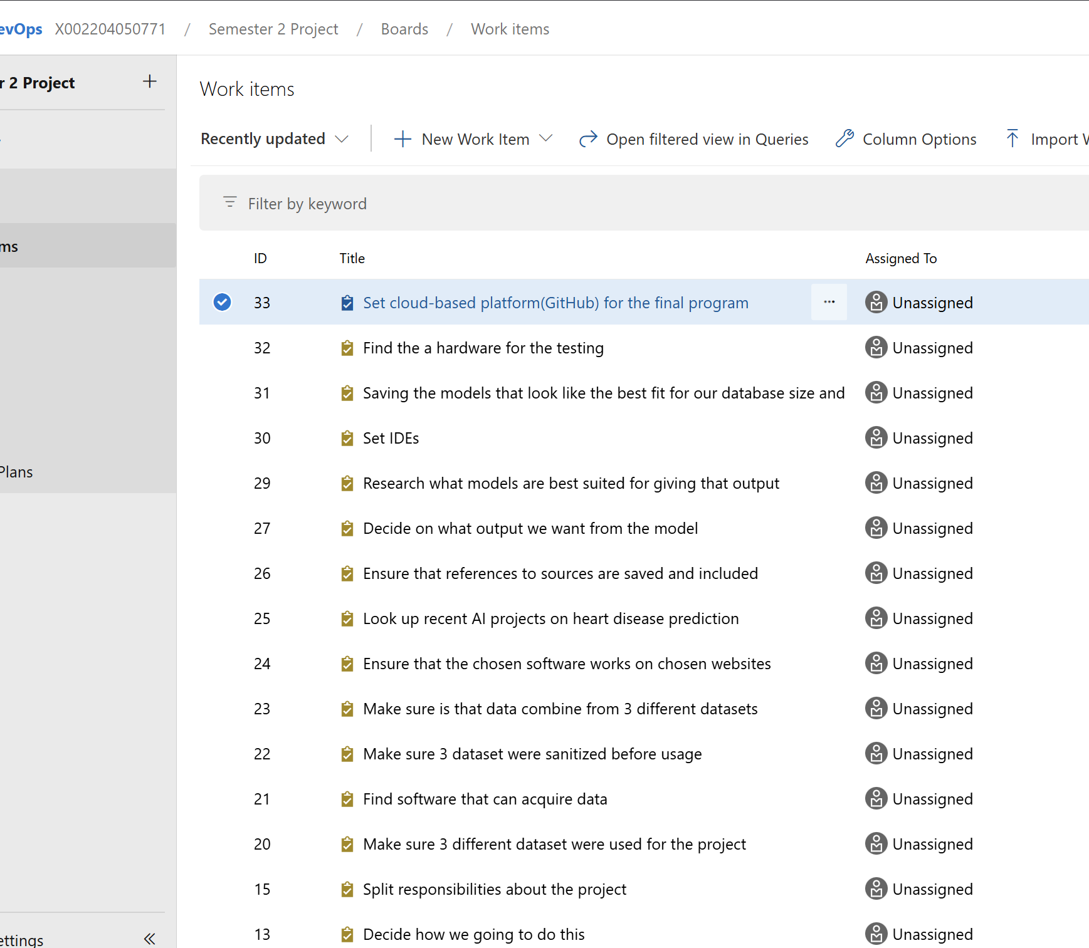
Azure DevOps Epics and Tasks
We used Azure dev ops to set our objectives and delegate the work between the three of us.
Azure was particularly useful for helping us understand what tasks were most important and to structure our priorities around the epics and tasks system we created.
Finally azure dev ops allowed us to track our completed tasks to get a better feel for how we are progressing.

Slide 9
Dataset Sources
Each member responsible for one dataset for exploration and preparation
Dataset contains structured clinical features and target variables
Datasets: Kaggle, Hugging Face and Kaggle.
- https://www.kaggle.com/datasets/neurocipher/heartdisease
- https://huggingface.co/datasets/aai530-group6/heart-failure-prediction-dataset
- https://www.kaggle.com/datasets/sintariosatya/heart-disease-dataset

Slide 10
Data Division for Training, Validation, Testing
Splits :
- 70% Training
- 15% Validation
- 15% Test
No overlap between datasets to avoid biased results
It enables the model to learn effective patterns

Slide 11
Conclusions
Multiple datasets to improve generalisation and robustness
Use of established machine learning models for comparison
Structured Azure Dev Ops plan with defined epics and tasks
Ready to proceed to data exploration and model development

Slide 12
Thanks!
Any questions?

